Slide 1
Enterprise Branch Network Design and Configuration using Cisco Packet Tracer
Presented by: Devika Bhujbal
Course: Cybersecurity with AI

Slide 2
Project Overview
Designed an enterprise branch network using Cisco Packet Tracer
Connected multiple branch and data-center networks
Configured IP addressing and subnetting
Implemented OSPF, RIP and BGP
Configured network services like DHCP and DNS
Implemented NAT/PAT for external connectivity
Configured SSH for secure remote management
Tested connectivity using Ping and Simulation Mode

Slide 3
How this project supports industries
Connects different offices – Helps the main office, branch office, and data center communicate.
Provides network communication – Routing protocols like OSPF, RIP, and BGP help data travel between different networks.
Manages devices easily – DHCP automatically gives IP addresses to computers.
Provides network services – DNS helps users access websites and services using names.
Provides secure access – SSH allows administrators to securely manage network devices.
Supports Internet access – NAT/PAT allows internal devices to communicate with external networks.
Helps with testing – Ping and Packet Tracer Simulation help check connectivity and packet movement.
Supports servers – The network can connect DNS, web, and other servers for business services.

Slide 4
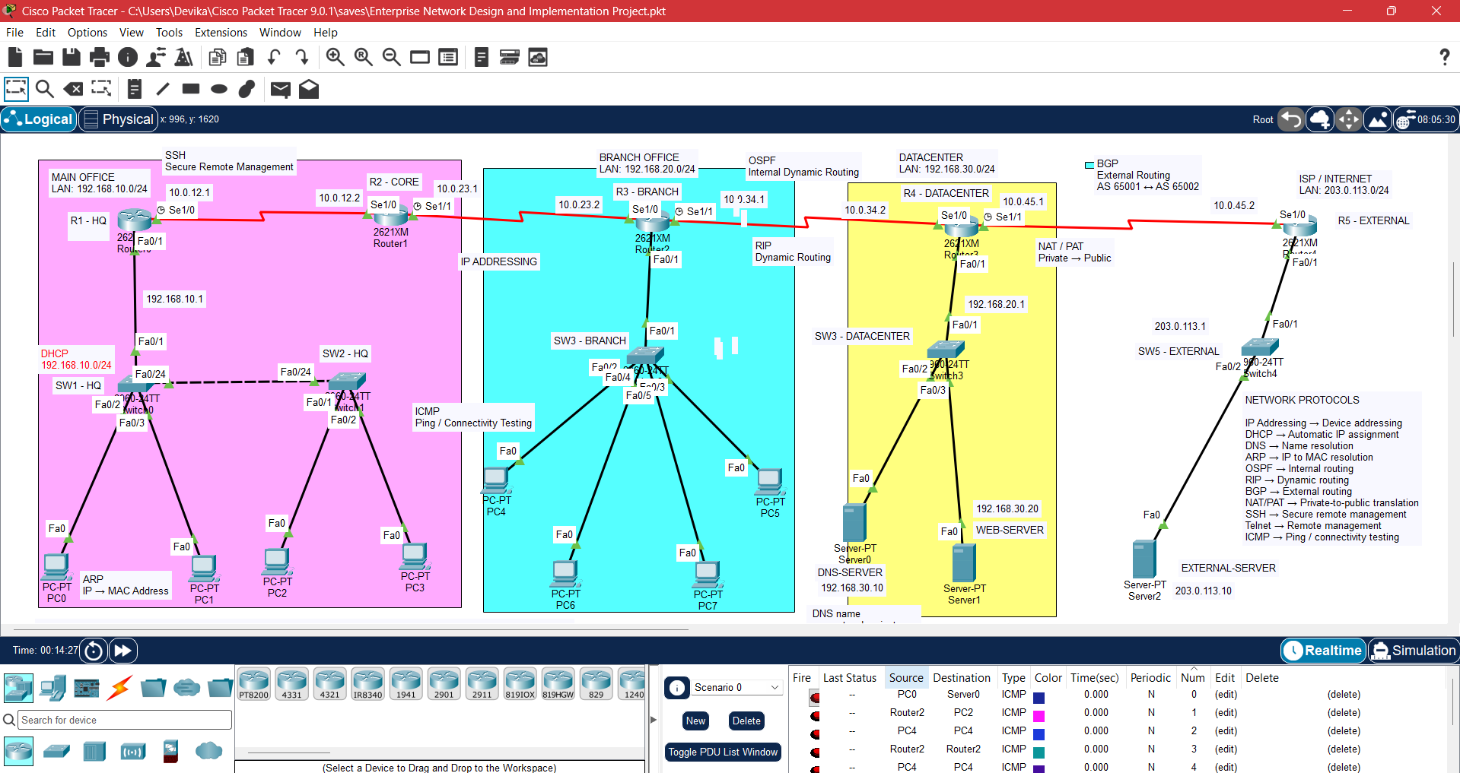
Network Topology
The network consists of interconnected routers, branch PCs, data center servers, and an external network.

Slide 5
IP Addressing & Network Segmentation
IP Addressing & Network Segmentation IP addressing is used to identify and communicate with devices within the network.
• HQ Network: 192.168.10.0/24
• Branch Network: 192.168.20.0/24
• Datacenter Network: 192.168.30.0/24
• External Network: 203.0.113.0/24
• Router-to-Router Links:
• R1–R2: 10.0.12.0/30
• R2–R3: 10.0.23.0/30
• R3–R4: 10.0.34.0/30
• R4–R5: 10.0.45.0/30
The network is divided into separate subnets to organize different departments and network segments. This provides structured addressing and allows communication between different networks.

Slide 6
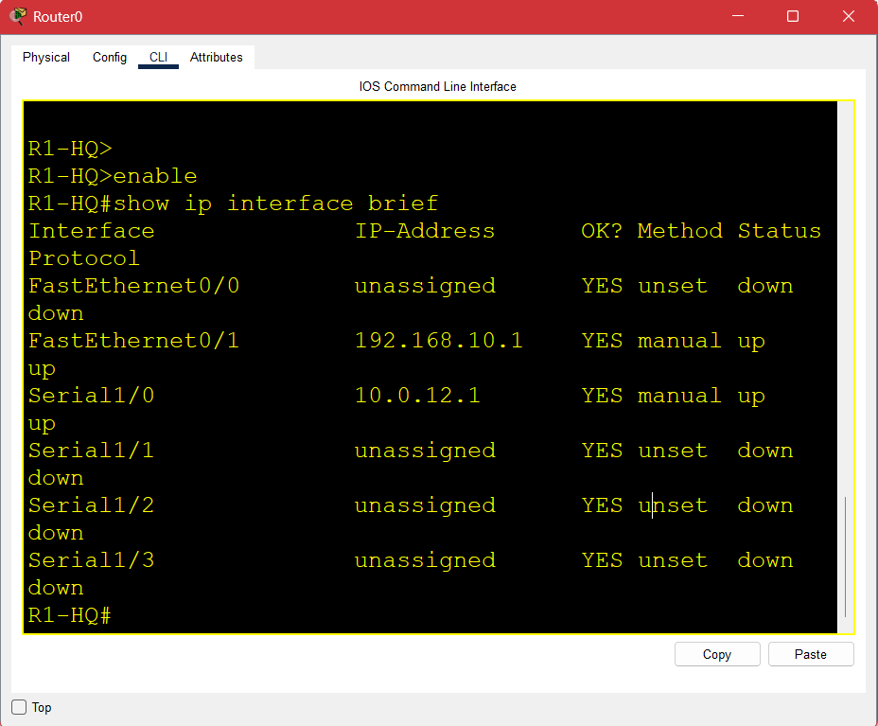
Router Configuration
R1-HQ connects the Main Office LAN to the Core Network
All routers were configured with the required IP addresses, interfaces, routing protocols, and network services.
R1-HQ – Main Office
R2-CORE – Core Network
R3-BRANCH – Branch Office
R4-DATACENTER – Data center
R5-EXTERNAL – External Network
Configured all five routers according to their role and connected them to form the complete enterprise network.
Example: R1-HQ
R1-HQ has:
Fa0/1: 192.168.10.1 → Main Office LAN
S1/0: 10.0.12.1 → Connection to R2-CORE

Slide 7
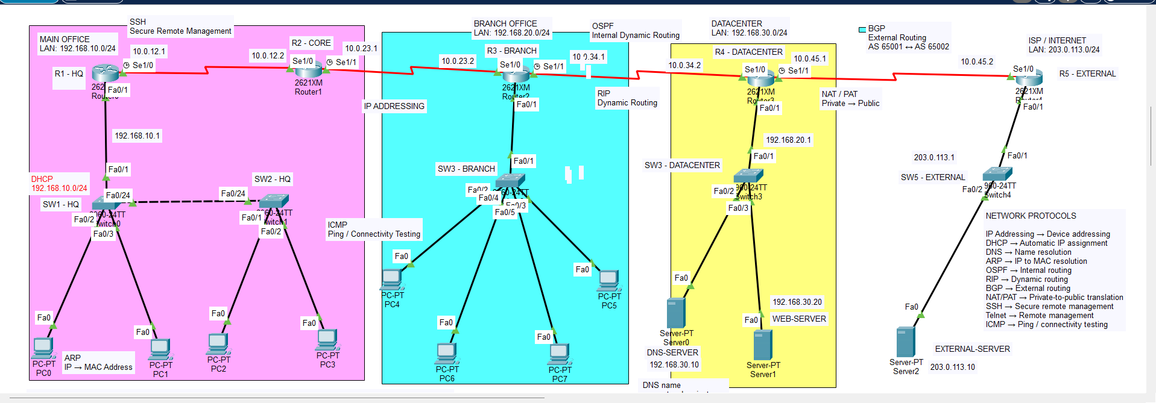
IP ADDRESSING - Logical workspace

Slide 8
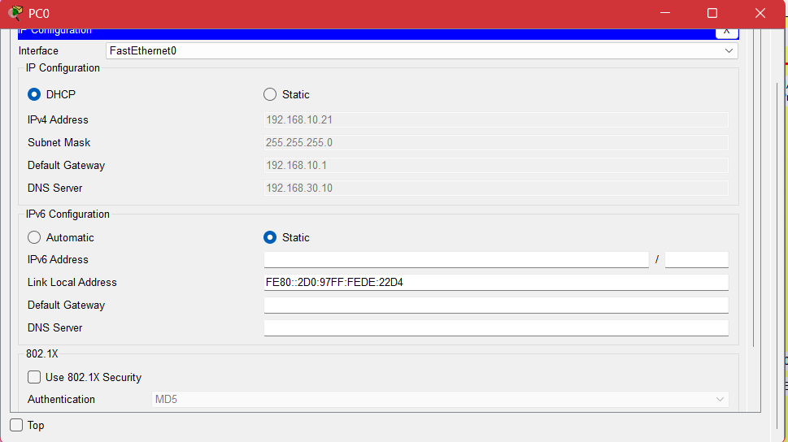
DHCP – Dynamic Host Configuration Protocol
DHCP automatically assigns IP addresses and other network settings such as the subnet mask and default gateway.
It reduces manual configuration and makes network setup easier.

Slide 9
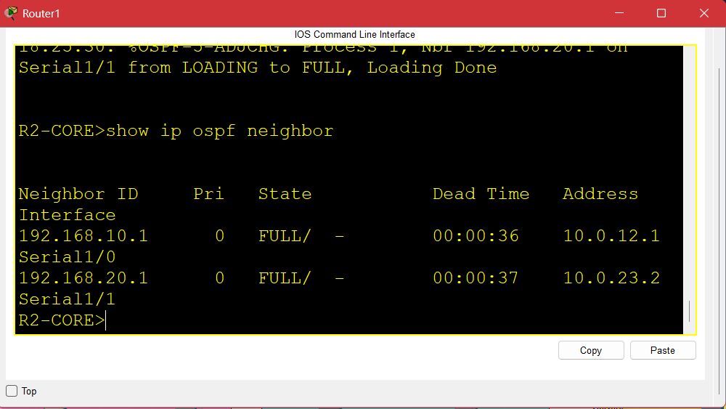
OSPF – Open Shortest Path First
OSPF is a dynamic routing protocol used to exchange routing information between routers within the network.
It helps routers learn the best available path to different networks.

Slide 10
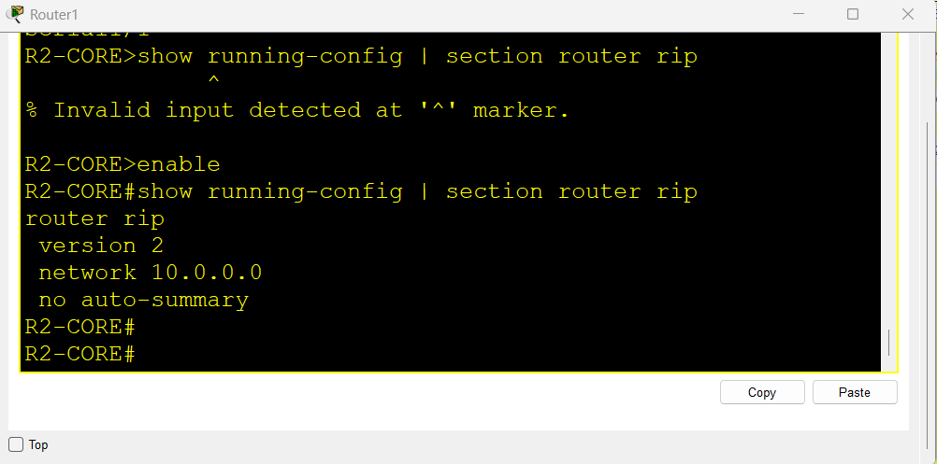
RIP – Routing Information Protocol
RIP is a dynamic routing protocol used to exchange routing information between routers.
It helps routers learn routes to different networks.
RIP is configured on the R2-CORE router.

Slide 11
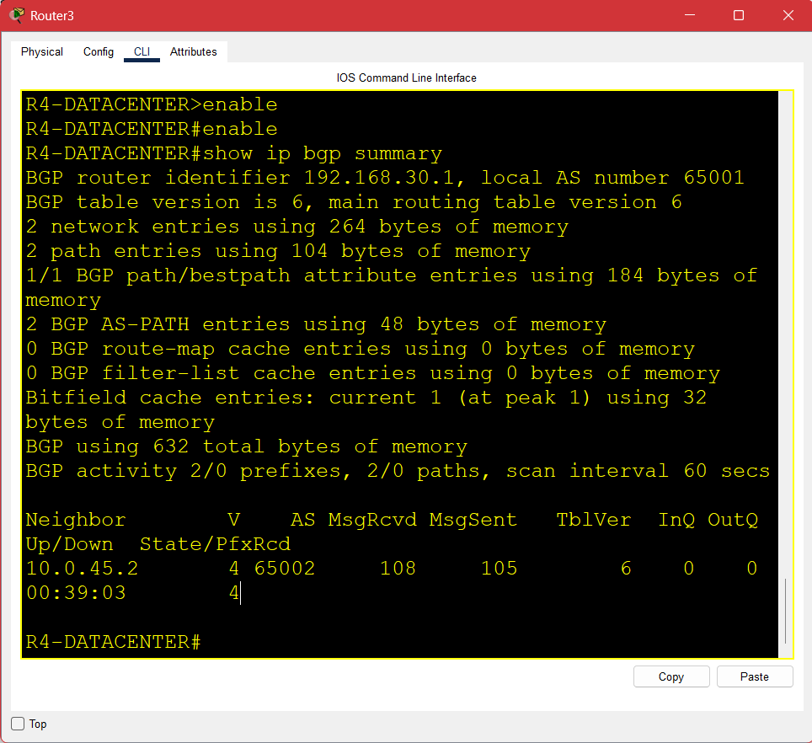
BGP – Border Gateway Protocol
BGP is used for routing between different Autonomous Systems (AS).
R4-DATACENTER uses AS 65001 and R5-EXTERNAL uses AS 65002.
BGP is configured between the R4-DATACENTER and R5-EXTERNAL routers.

Slide 12
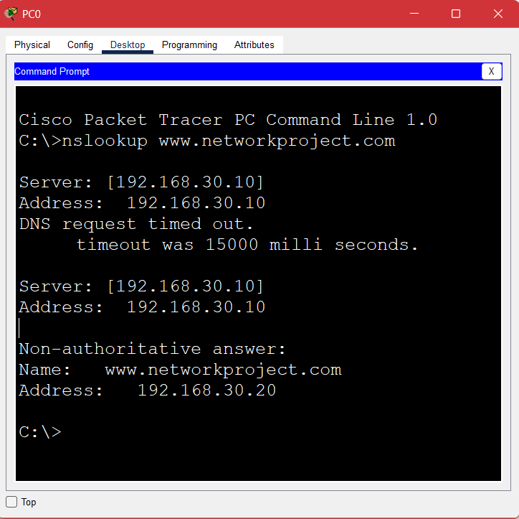
DNS – Domain Name System
DNS converts a domain name into its corresponding IP address.
Server: 192.168.30.10
Domain: www.networkproject.com
Web Server: 192.168.30.20
DNS is configured on the Server0 / DNS-SERVER in the R4-DATACENTER network.

Slide 13
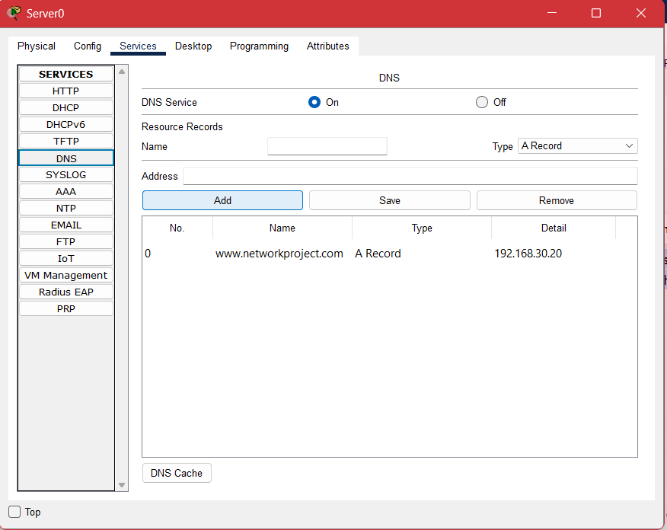
DNS Service Configuration
Configured on: DNS-SERVER (192.168.30.10)
DNS Service: ON
A Record: www.networkproject.com → 192.168.30.20
The DNS server stores the domain name and its IP address. It helps users find the correct web server.

Slide 14
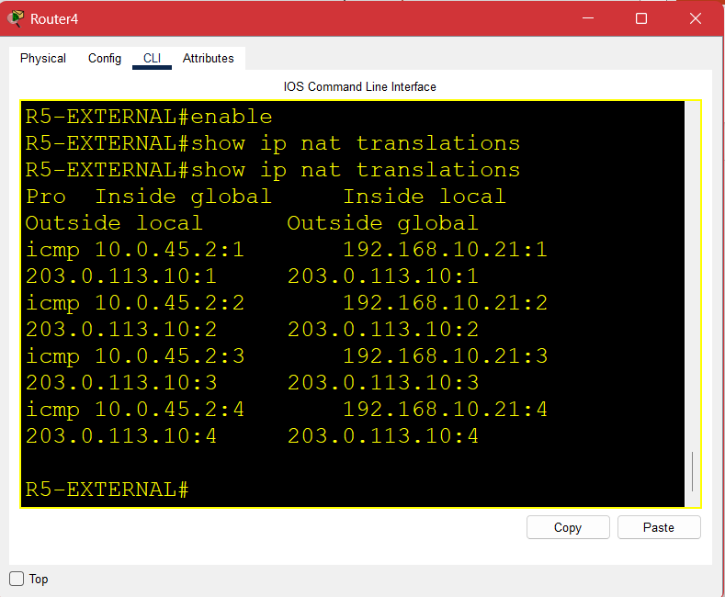
NAT / PAT – Network Address Translation
NAT translates private IP addresses into addresses used for communication with external networks.
It allows internal devices to access the external network.
Inside Local: 192.168.10.21 Inside Global: 10.0.45.2
NAT/PAT is configured on the R5-EXTERNAL router.

Slide 15
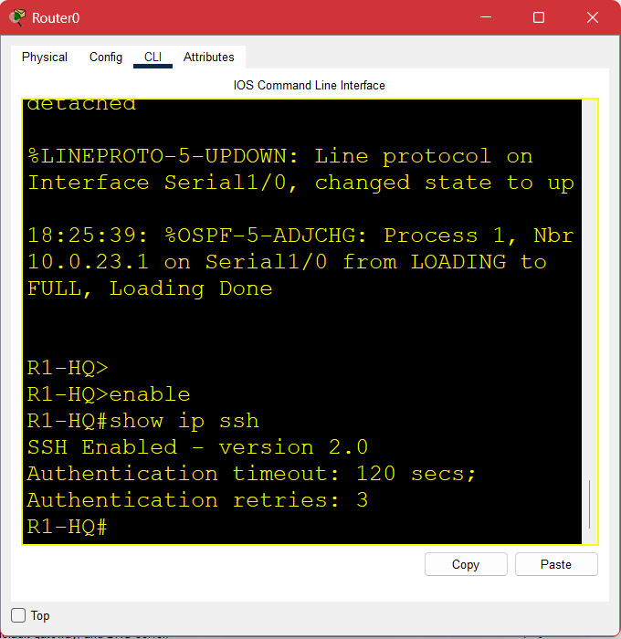
SSH – Secure Shell
SSH provides secure remote access to network devices for management and configuration.
It uses encrypted communication and authentication to protect remote access.
SSH is configured on the R1-HQ router.
SSH = Secure remote access

Slide 16
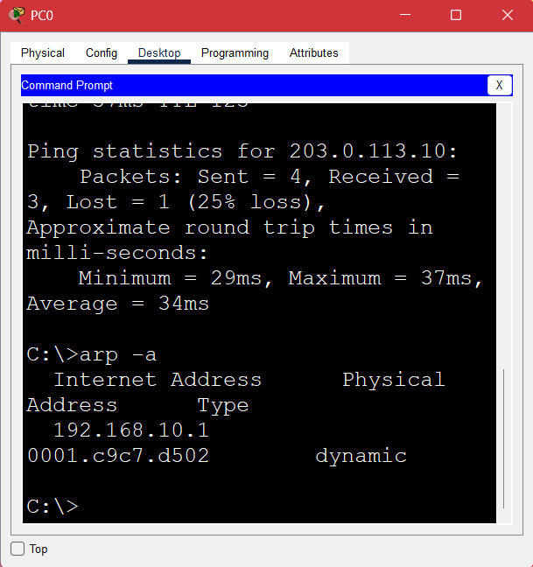
ARP – Address Resolution Protocol
ARP finds the MAC address associated with an IP address within the local network.
Configured on:
ARP is used by the PCs and network devices for local network communication.
ARP = IP address → MAC address

Slide 17
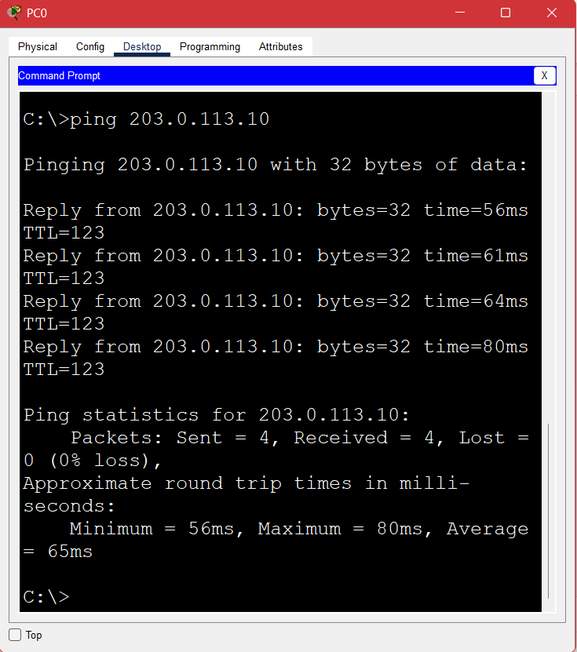
ICMP – Internet Control Message Protocol
ICMP is used to test network connectivity between devices using the ping command.
Configured on:
ICMP is used between network devices and PCs for connectivity testing.
ICMP = Connectivity testing

Slide 18
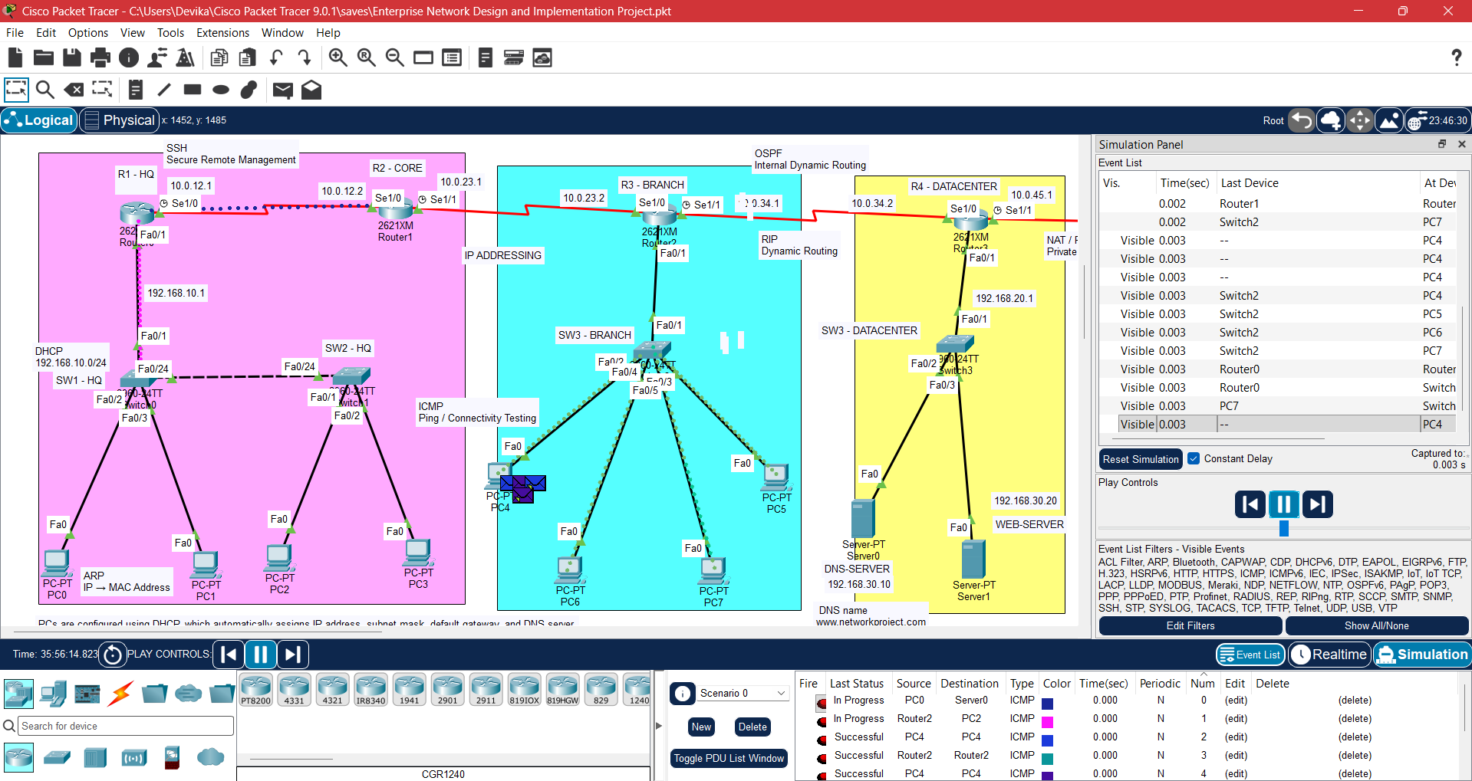
PACKET TRANSFER – SIMULATION MODE
Simulation Mode helps visualize how packets travel through the network from source to destination.

Slide 19
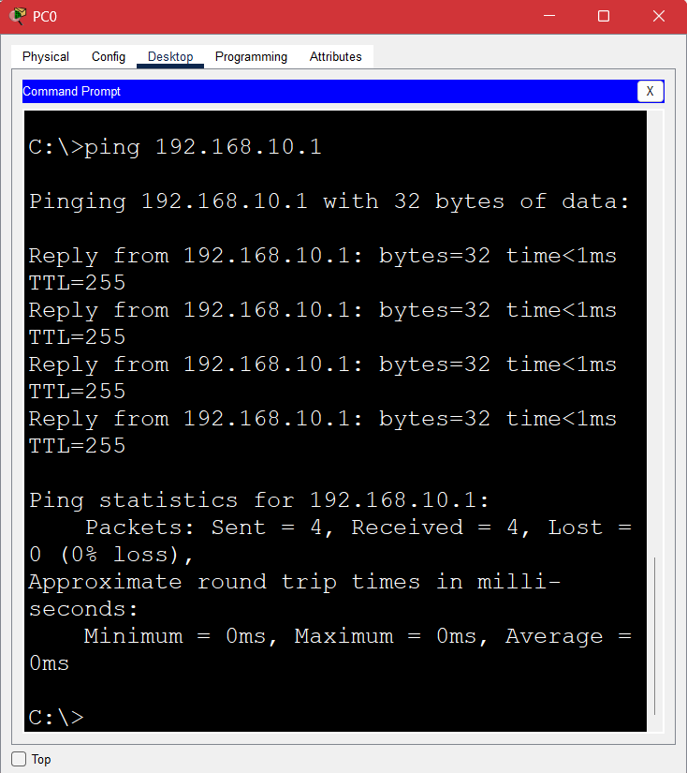
Network Testing & Results
The network was tested using ping, DNS lookup, NAT translation and routing verification.
Successful communication was verified between different network segments.
Testing = Verify connectivity and services
HQ network >

Slide 20
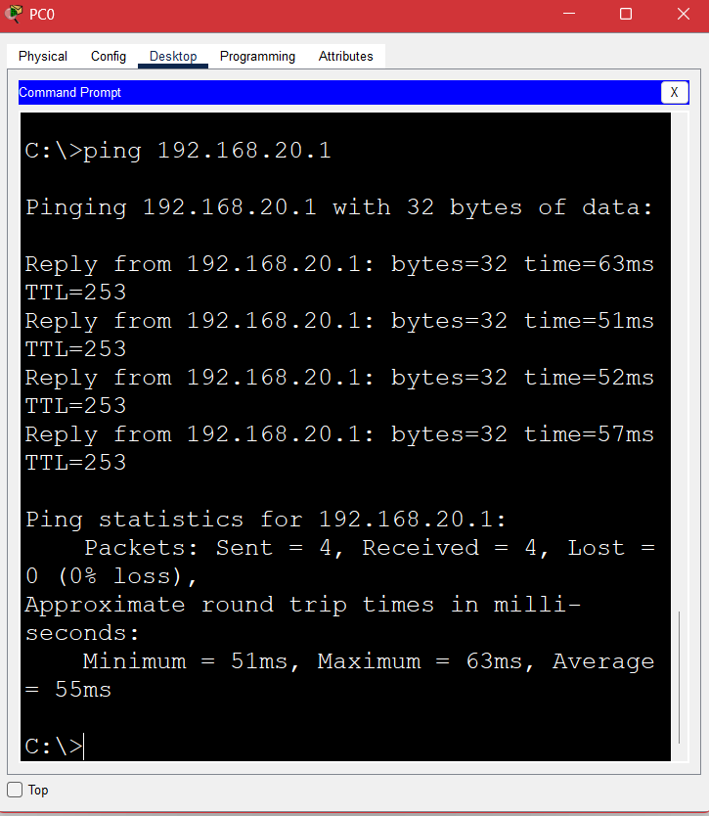
2. Branch network
R3-BRANCH

Slide 21
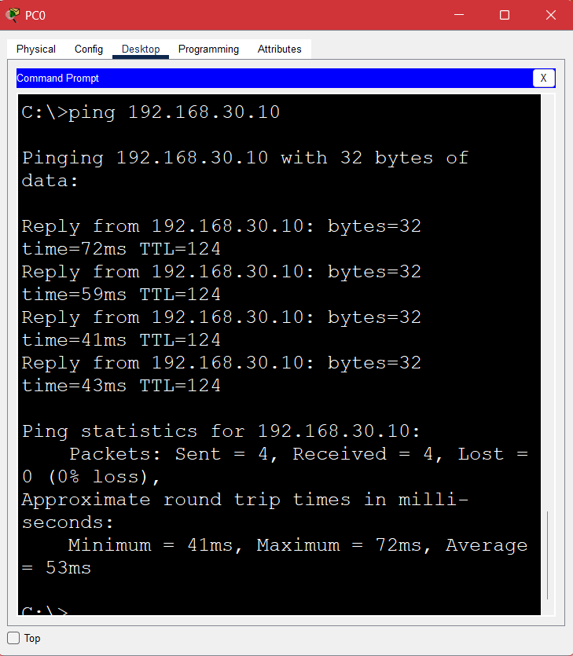
3. Datacenter network
I tested connectivity between the HQ, Branch, Datacenter and External networks using ping, and all the tests received successful replies.

Slide 22
Conclusion
The enterprise network was successfully designed and configured using Cisco Packet Tracer.
IP addressing, routing protocols, network services, NAT/PAT and secure remote access were implemented and tested successfully.
The network was configured across the HQ, Core, Branch, Datacenter and External routers and their connected devices.

Slide 23
Thankyou.

